Slide 1

Fr. Conceicao Rodrigues Institute of Technology, Vashi
Department of Electronics and Telecommunication Engineering
RFID ATTENDANCE BASED SYSTEM
Group no: (BATCH NO: 3)
Prathamesh Shedale 3021149
Kartik Sonawane 3021152
Vedant Thakur 3021154
Vivek Todkar 3021155
Under the guidance of
Mr. Ankur G.
Group

Slide 2
Contents
Introduction
Project Objectives and problem statement
Literature Survey
Block Diagram
Working Principle
Project Specifications
Implementation
Results and discussion
Plan of Action
References

Slide 3
PROBLEM OVERVIEW:
The traditional attendance system using manual methods such as sign-in sheets or roll calls is time consuming and prone to errors. There is a need for a more efficient and accurate attendance system that can be easily integrated into existing systems. The system should use RFID technology to read and store the unique identification of students' RFID tags and use the Arduino microcontroller to process this information. The attendance data should be stored in a database and can be retrieved for analysis and record-keeping purposes. The system should be easy to use and should provide real-time updates on the attendance status of students in the classroom.

Slide 4
PROJECT OBJECTIVES:
To design and implement an RFID-based attendance system using an Arduino and RPI microcontroller that is efficient, accurate, and easy to use.
To utilize the Raspberry microcontroller to process and manage the attendance data.
To provide real-time updates on the attendance status of students in the classroom.
To implement the use of RFID technology for reading and storing students' identification data.
To create a database to store the attendance information for recordkeeping and analysis purposes. To improve the accuracy and efficiency of the attendance tracking process compared to traditional methods.

Slide 5
LITERATURE SURVEY
Sr. No. | Title | Author (Year) | Source | Methodology
1. | An Efficient RFID Attendance Management System Using Raspberry Pi | S. P. Kale and P. P. Khode (2019) | International Conference on Informatics, Electronics and Vision (ICIEV) | The system implements LASER as a mean of detecting intruders. A wireless sensor network based on nRF24L01 transceiver is used to communicate with the gateway and the sensors. LDRs attached to an Arduino board; which is programmed to take decisions whether to sound an alarm or call a user through a GPRS/GSM network;
2. | Design and Implementation of RFID Based Attendance System using Arduino | M. A. Al-Wakeel (2018) | Jour of Adv Research in Dynamical & Control Systems | The idea has been applied on electrical engineering department in University of Wasit. Which is almost there are 25 students for each class belong this department Because, when the lecturer takes the registration attendance quarter hour from the lecture time will be loss, in spite of the error that maybe occurs, such as students are not attentive to hear their names, or fatigue hit the lecturers during the class.
3. | Attendance and Information System using RFID and Web-Based Application for Academic Sector | Hasanein D. Rjeib (2018) | International Journal of Advanced Computer Science and Applications, | The proposed system is achieving two aims, the first objective is to register, record, and manage a student attendance using RFID tag, and the second aim is to provide student information service such as timetable, lecture time and classroom number, and other student-related data that displayed in screen or LCD. T

Slide 6
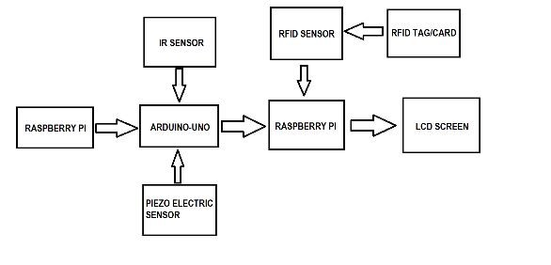
BLOCK DIAGRAM

Slide 7
WORKING PRINCIPLE:
An RFID reader is used to detect the presence of an RFID tag, which is typically a small, passive device that contains a unique identifier. When an RFID tag is brought close to the reader, it sends the tag's identifier to the microcontroller or the Raspberry Pi, which is connected to the reader. The microcontroller or Raspberry Pi processes the identifier and compares it to a database of known RFID tags. If the identifier is recognized, the microcontroller or Raspberry Pi logs the attendance data, which includes the time and date of the attendance and the identifier of the RFID tag. The collected data can be displayed on an LCD screen or stored in a database for later analysis. The Raspberry Pi can also be connected to the internet to update the attendance data in a centralized database or send notifications via email or SMS

Slide 8
PROJECT SPECIFICATIONS:
SR.No. | NAME OF THE COMPONENT | POWER SUPPLY | OTHER SPECIFICATIONS
1 | U1 Arduino Uno R3 | 5v | It is an open-source computer hardware and software company, project and user community that designs and manufactures microcontroller-based kits for building digital devices and interactive objects that can sense and control objects in the physical world.
2 | PIEZO 1 (Piezo) | 5v | A piezo buzzer is an electric device used to produce a tone. Piezoelectric components are made of special materials that exhibit the piezoelectric effect (where the material can convert some energy from applied mechanical strain into an electric charge).
3 | IR | 5V | PIR sensors are most commonly used in motion-based detection, such as in-home security systems. When a moving object that generates infrared radiation enters the sensing range of the detector, the difference in IR levels between the two pyroelectric elements is measured.
4 | R1 1kΩ Resistor P1 5,5 Power Supply D1 Red LED | 5v | A passive electrical component with two terminals that are used for either limiting or regulating the flow of electric current in electrical circuits.

Slide 9
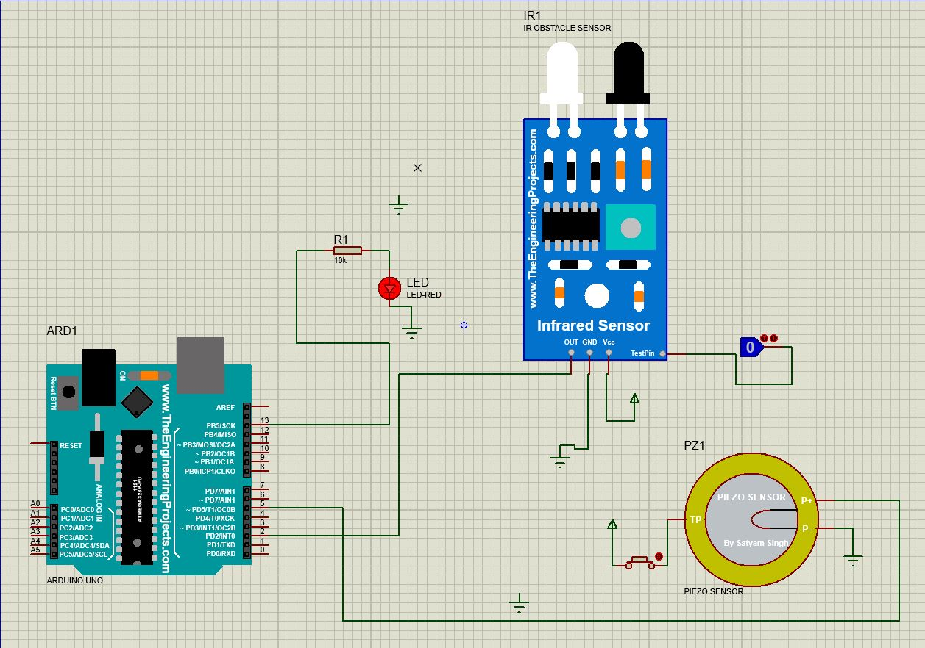
IMPLEMENTATION (proteus)
Schematic Diagram of the Circuit

Slide 10
const int IRSensor = 2;
const int ledPin = 13;
const int Buzzer =12;
const int sensor =5;
const int led =4;
void setup()
{
pinMode(IRSensor, INPUT);
pinMode(sensor, INPUT);
pinMode(ledPin, OUTPUT);
pinMode(Buzzer, OUTPUT);
pinMode(led, OUTPUT);
Serial.begin(9600);
}
void loop()
{
int value = digitalRead(sensor);
if (value == HIGH)
{
digitalWrite(led, HIGH);
delay(500);
}
else
{
digitalWrite(led, LOW);
}
int sensorState = digitalRead (IRSensor);
if (sensorState == LOW)
{
digitalWrite(ledPin, LOW);
digitalWrite(Buzzer, LOW);
}
else
{
digitalWrite(ledPin, HIGH);
digitalWrite(Buzzer, HIGH);
}
}
IMPLEMENTATION :result

Slide 11
IMPLEMENTATION
const int IRSensor = 2;
const int ledPin = 13;
const int Buzzer =12;
const int sensor =5;
const int led =4;
void setup()
{
pinMode(IRSensor, INPUT);
pinMode(sensor, INPUT);
pinMode(ledPin, OUTPUT);
pinMode(Buzzer, OUTPUT);
pinMode(led, OUTPUT);
Serial.begin(9600);
}
void loop()
{
int value = digitalRead(sensor);
if (value == HIGH)
{
digitalWrite(led, HIGH);
delay(500);
}
else
{
digitalWrite(led, LOW);
}
int sensorState = digitalRead (IRSensor);
if (sensorState == LOW)
{
digitalWrite(ledPin, LOW);
digitalWrite(Buzzer, LOW);
}
else
{
digitalWrite(ledPin, HIGH);
digitalWrite(Buzzer, HIGH);
}
}

Slide 12
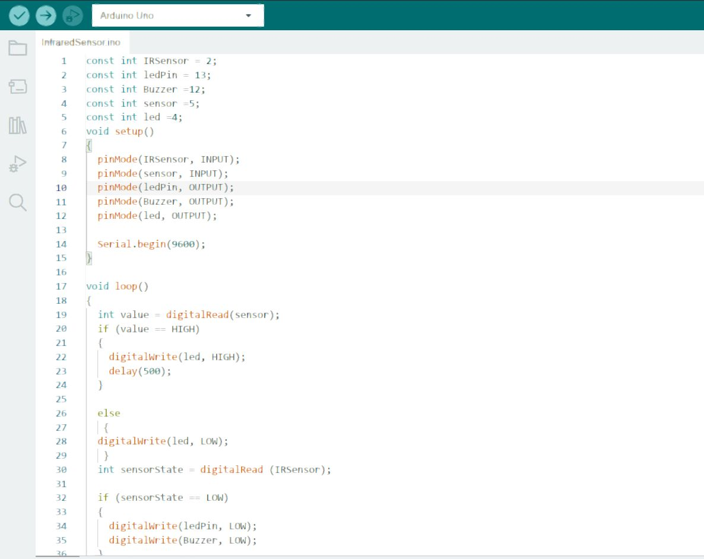
IMPLEMENTATION :

Slide 13
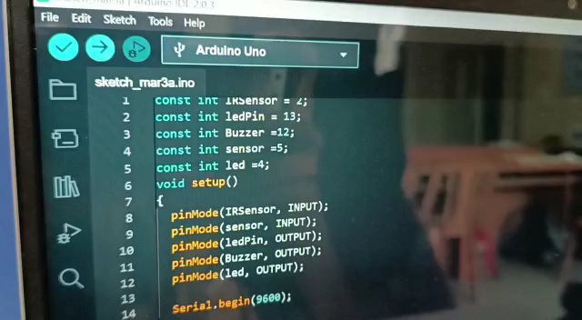
ARDIUNO OUTPUT:-

Slide 14
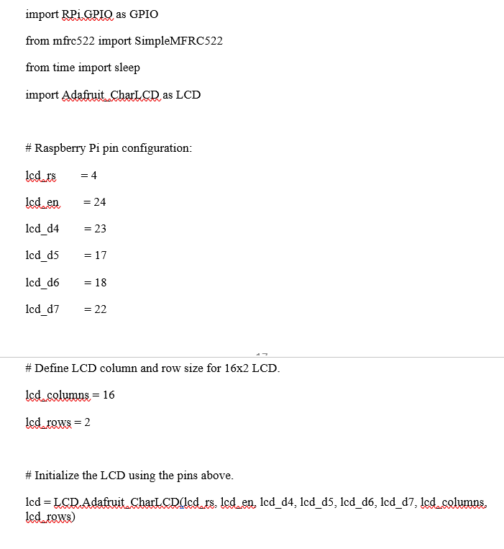
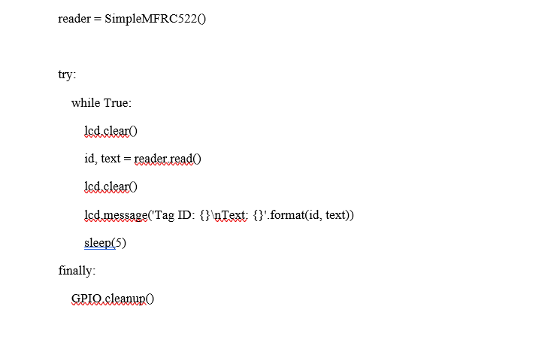
RPI CODE:-

Slide 15
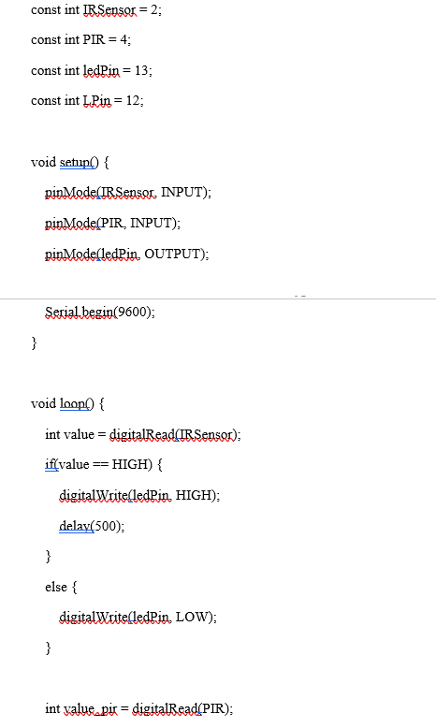
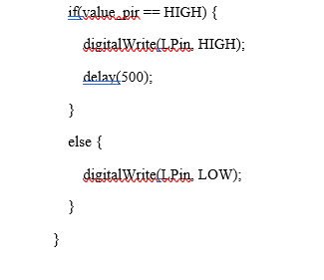

Slide 16
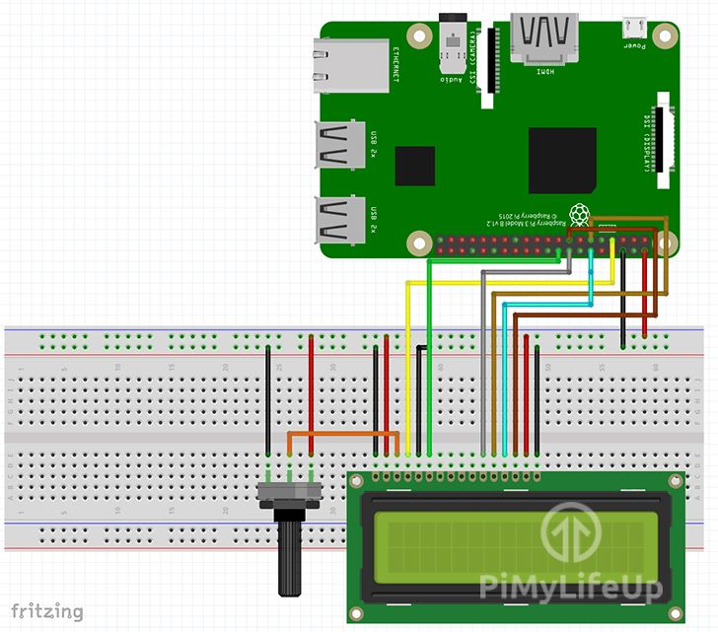
RPI CIRCUIT :-

Slide 17
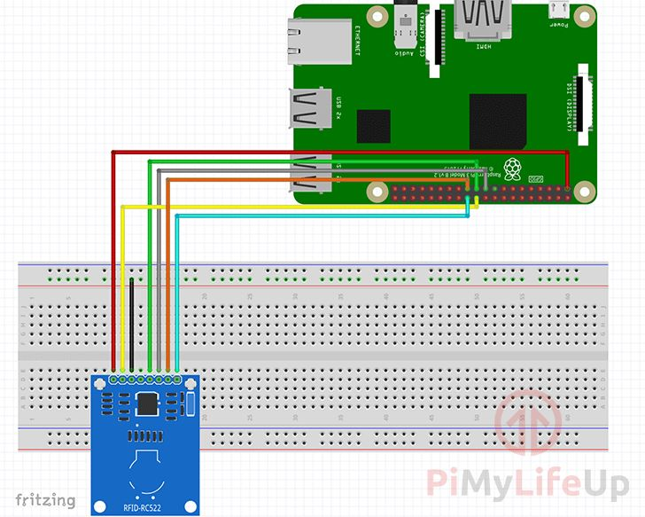

Slide 18
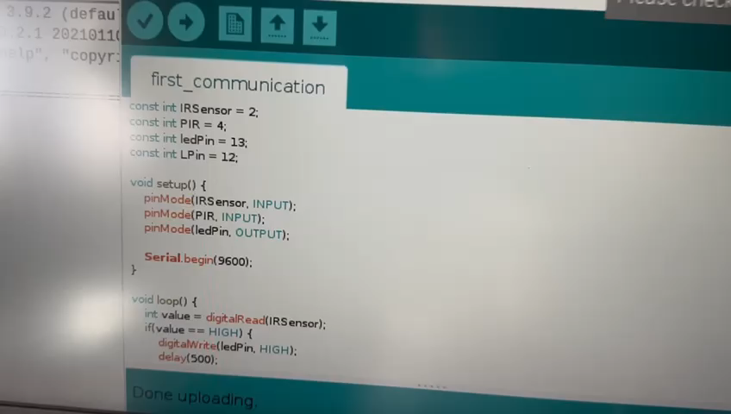
FINAL OUTPUT:-

Slide 19
RESULTS AND DISCUSSION :
Attendance management is one of the most crucial tasks in an educational institution- school, college, or university. Daily student attendance allows teachers to keep a tab on students’ activities
.
It also enables parents to understand whether their children are attentive towards studies & attend their class regularly.
However, managing the daily attendance of thousands of students is quite a challenging task for teachers. Traditional means of registering daily students’ attendance may result in errors & tremendous manual work.
An RFID based attendance system can be a great solution to overcome such challenges as it automates the students’ attendance process & enables teachers and parents to track & monitor students’ activities effortlessly.

Slide 20
Thank You

